Slide 1

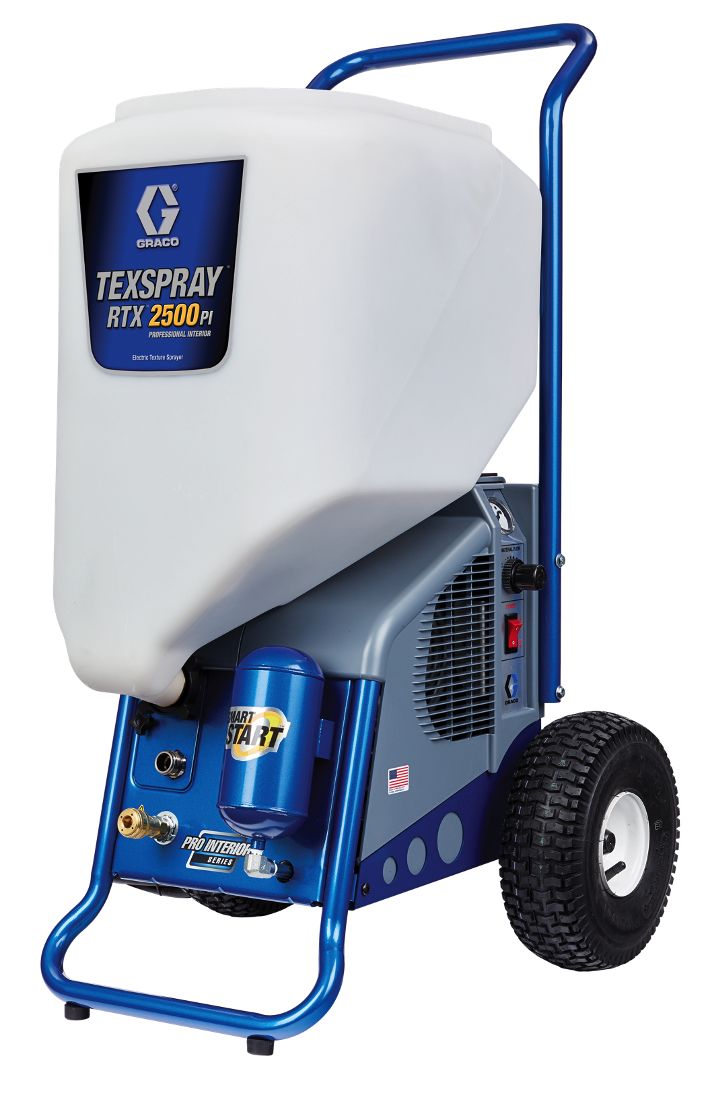
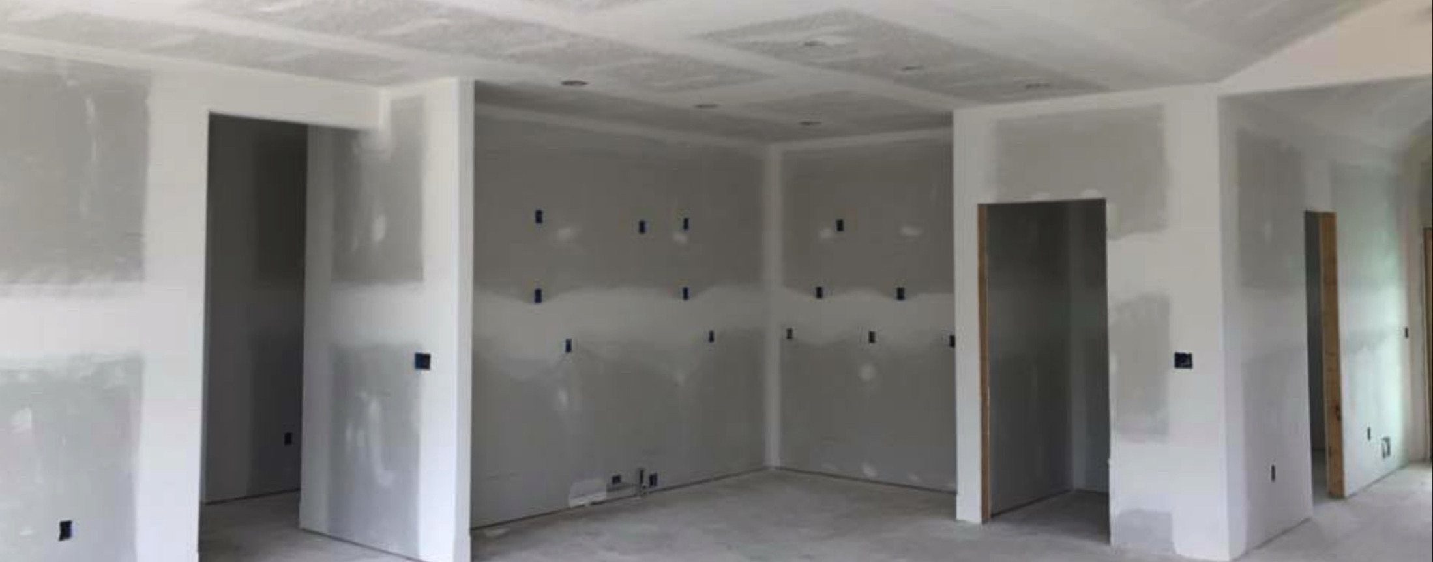

NEW FOR 2018
TEXSPRAY RTX 2500PI

Slide 2
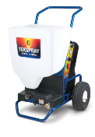
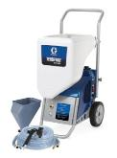
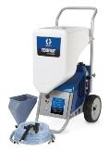
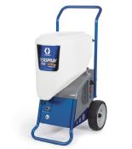
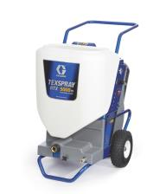
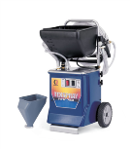
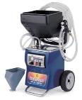
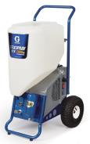

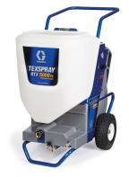
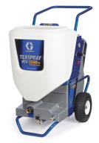
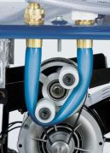
HISTORY OF RTX
2003
2004
2007
2016
RTX 900
RTX 5000PI
RTX 1000
RTX 650
RTX 1250
RTX 1400SI
RTX 2000PI
RTX 750
RTX 1500
Soft-Start Technology
Tool-less Pump Removal
New Standard in Performance
Introduction of RotoFlex Technology!
RotoFlex II
New Smaller/Lighter Design
Higher performance
RTX 5000PX
RTX 5500PX
SmartStart
MaxPower DC Motor
WideTex
Segmented Interior and Exterior Models
Breakthrough Performance
Notes:
List $3900

Slide 3
BACKGROUND
Since launch in 2003, RTX has proven to be the sprayer of choice for contractors applying interior texture finishes
Launch of new line-up in 2016 offered huge performance gains, valuable features and superior finishing capability, but we LEFT A HUGE GAP in performance and price between the RTX 2000PI and RTX 5000PI
  Contractors want an interior unit which is more forgiving with heavy-bodied materials (like the RTX 5000PI), but is closer to size and price to RTX 2000PI
Launch new RTX 2500PI to fill a Price and Performance gap in current lineup
Offer as “cross-over” unit offering:
  Size of a smaller machine
  Performance of a larger machine
  Priced positioned between small and large machines
STRATEGY
Notes:
Less words fill gap

Slide 4



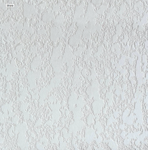

APPLICATIONS/MATERIALS
ORANGE PEEL
SPLATTER
ACOUSTICS/TEXTURED/ GOTELE
KNOCKDOWN
PUTTY/GYPSUM/FOG
SPRAY THIS AND MORE!
Notes:
Optimized for interior, but capable with more. Everyone in this room has these applications being done in their territory!

Slide 5
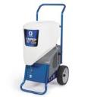

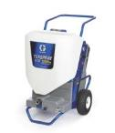

CURRENT LINEUP
EST MARKET PRICE
$1,000
$2,500
$4,000
$1,750
$3,250
GAP IN RTX LINEUP
“Sweet Spot” for Pro’s who are looking for best productivity and heavy-material capability at a price below the RTX 5000PI
Graco now has technology to offer a great solution!
INTERIOR
RTX 1400SI
70 psi
1.4 gpm
$1400 Est. Market
RTX 2000PI
70 psi
2.0 gpm
$2000 Est. Market
RTX 5000PI
100 psi
5.0 gpm
$3500 Est. Market
RTX 1500 (DISCONTINUED)
100 psi
2.6 gpm
$2500 Est. Market
Notes:
List $3900

Slide 6
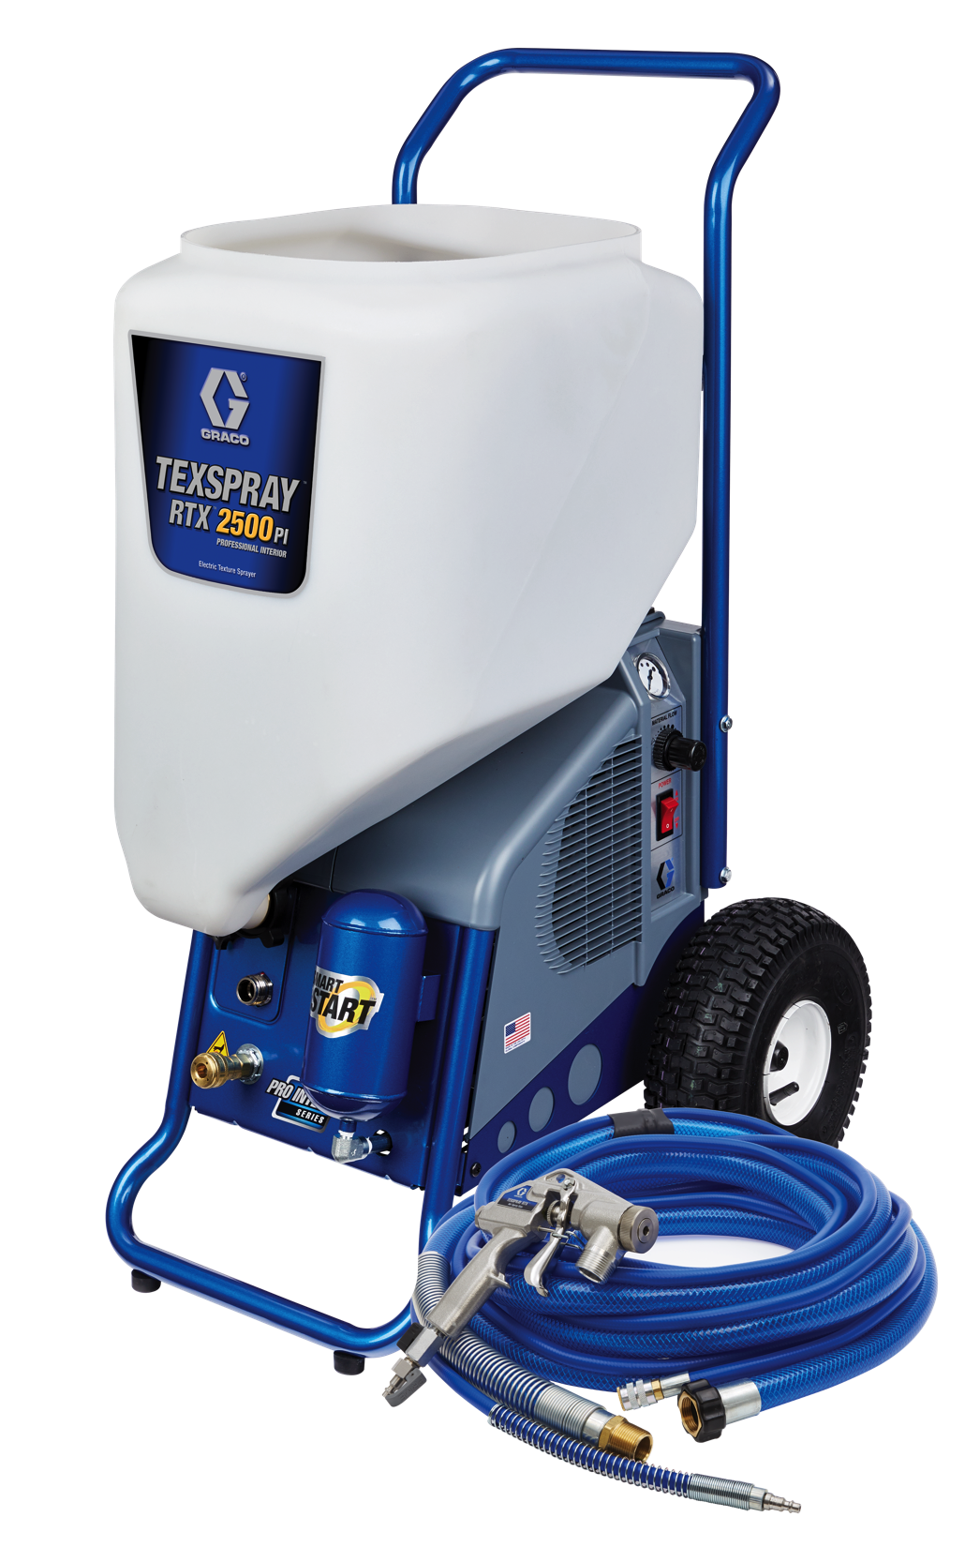





RTX 2500PI KEY FEATURES
15 GALLON HOPPER
Extra-Large inlet for heavy-bodied materials – 4X more flow area than RTX 2000PI
Steep design keeps the material flowing
The proven one-piece pump that always delivers!
Now optimized to deliver more!
Finish Faster with:
  42% More Pressure
  25% More Flow
Automatically Starts & Stops the sprayer when trigger is pulled
Reduces noise while extending Critical Component life
Tool-less Pump Removal and Installation System
Eliminates Downtime – Swap the pump right on the job!
Extra Wide “Fan” Pattern Texture Tips
The Fastest Way to a Superior Texture Finish!

Slide 7
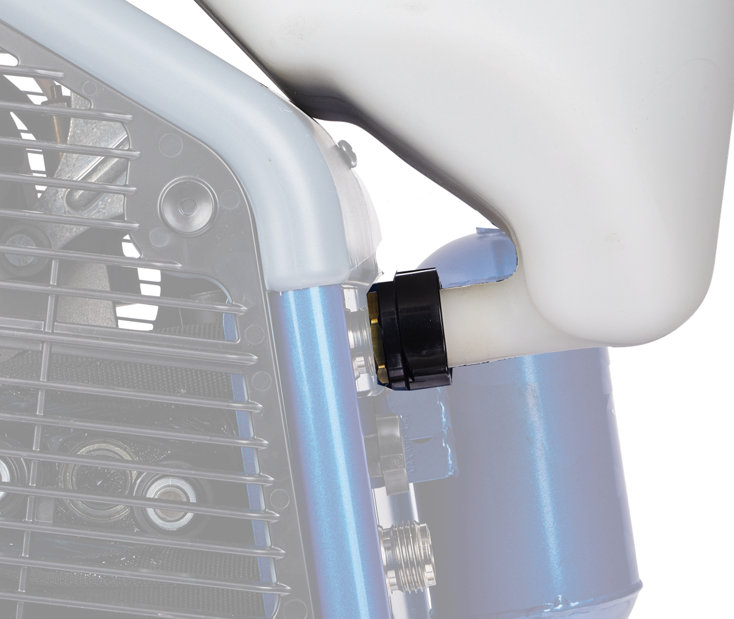
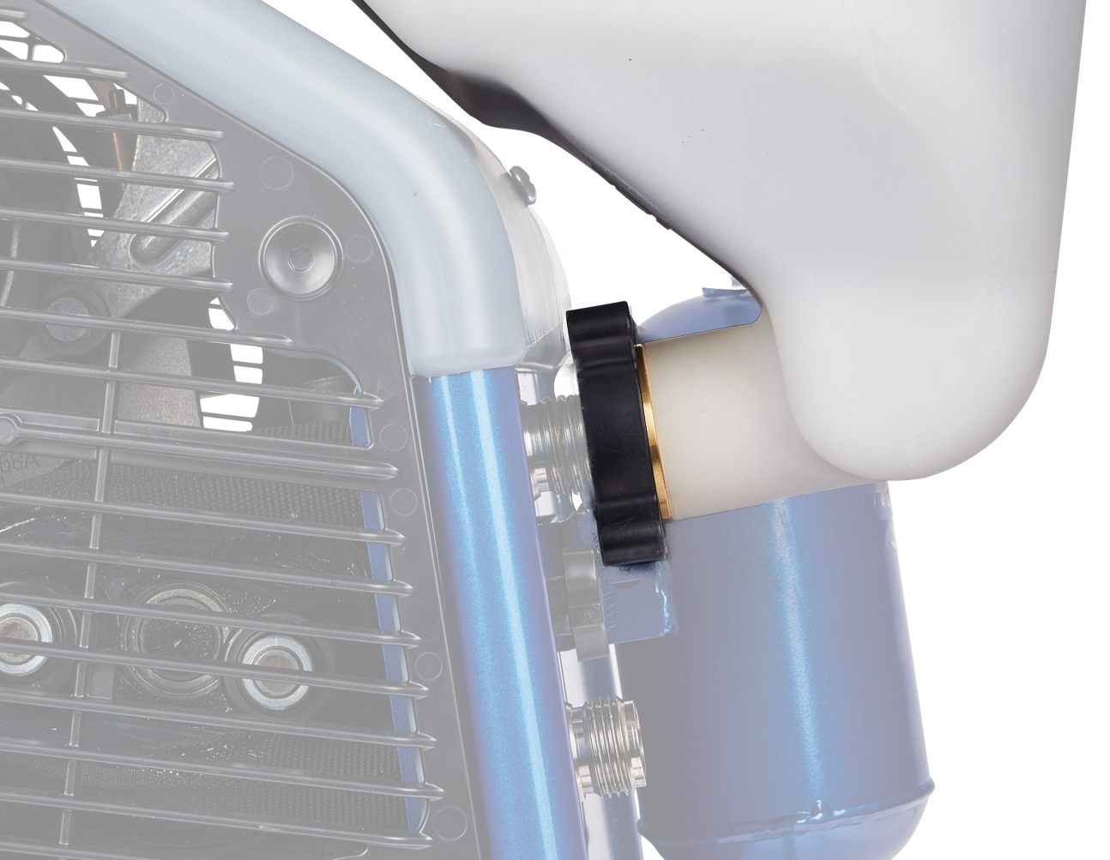
15 GALLON HOPPER
NEW LARGE SIZE WITH OVERSIZED PASSAGES
SPEND LESS TIME FILLING AND MORE TIME SPRAYING
Steep sided design keeps the thick material moving
No tools removal with oversized hand nut
Virtually indestructible
4X More Inlet Flow area is thick-mix friendly
4X MORE FLOW AREA!
*RTX 2000PI inlet
RTX 2500PI inlet
Notes:
When we talk about truly breakthrough features we are talking about features like the new SmartStart!
SmartStart makes your sprayer run more like an airless sprayer – pull the trigger - it turns on, let go and it instantly shuts off!
Basically, if your not pulling the trigger, it isn’t running – and neither is the pump and neither is the air compressor!
Talk about a great way to improve component life!
It also is a hell of a lot quieter! No more running when your done spraying!
SmartStart also features soft-start. This eliminates the material blast that would happen when you pull the trigger under pressure. Instead, the system automatically relieves pressure instantly after each trigger pull and slowly ramps up when the trigger is pulled
This has always been a great feature on the RTX 1500 and is now on everything that has SmartStart
Contractors who have used the SmartStart feature absolutely love it. It totally eliminates trips back and forth to the machine just to turn on and off the machine.Contractors have told us they would buy units just to have SmartStart – its that BIG!

Slide 8


RTX 2500PI
AC ELECTRIC MOTOR
High-Output design offers more power and performance than ever before
Single-motor design operates both the air compressor and the RotoFlex pump
ROTOFLEX™ II PUMP
NOW PUMPS HEAVIER MUDS
42% MORE PRESSURE to easily handle the heavy materials
25% MORE FLOW to get the job done – quickly
Jobsite proven!
FLEXCHANGE™
No-Tools pump replacement system – now easier than ever!
Swap to a spare RotoFlex pump in seconds!
Eliminate costly jobsite downtime
SMARTSTART™ SYSTEM
Innovative system automatically starts pump and compressor when gun trigger is pulled, and shuts them off when released
Provides a soft-start to eliminate material blast that can impact finish quality
Reduces noise and vibration
Extends pump and compressor life
LARGE 15-GALLON HOPPER
Extra-large inlet optimized for heavier-bodied materials
15% larger capacity
Steep design keeps the material flowing
WIDETEX™ TIPS & ADAPTER
Allows spraying in a uniform fan pattern
Spray repeatable patterns with less material and pressure adjustment
Increases productivity by more than 20%!
HIGH-OUTPUT 6.1 cfm AIR COMPRESSOR
High-output design delivers 33% more air for demanding finishes
Maintenance-free design
RTX 2500PI INCLUDES
1 in x 25 ft Material Hose
3/8 in x 25 ft Air Hose
Heavy Duty Texture Gun
3mm, 4mm, 6mm, 8mm, 10mm, 12mm round nozzles
WideTex Adapter with W4, W6, W8, W10, W12, XL tips
HD ALUMINUM TRIGGER GUN WITH INTEGRATED PRIME SELECTOR
Durable aluminum design
Oversized fluid/air passages
Allows unit to be put in prime mode right at the gun!
SKIP-BOND MATERIAL/AIR HOSE
Both hoses permanently bonded in for easy handling
Offers more flexibility than ever before

Slide 9



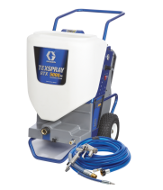
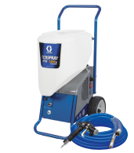
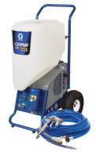
INTERIOR SERIES
EVERYDAY RELIABILITY
WORK SMARTER, FINISH MORE OBS
The features you want to get the finish you need
Optimized to get you on, and off the job faster
Ideal for the Residential and Remodel Contractor who:
Applies Texture periodically
Has jobs typically on the smaller side
Demands everyday reliability
Doesn‘t need a lot of features
Ideal for the Large Residential and Commercial Contractor who:
Textures everyday
Has medium to large jobs
Moves frequently from job to job
Needs features that save time to get to the next job site

Slide 10
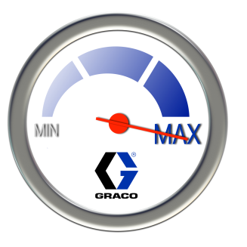
PERFORMANCE SPECS
 | RTX 1400SI | RTX 2000PI | RTX 2500PI | RTX 5000PI
GPM | 1.4 | 2.0 | 2.5 = 25% MORE | 5.0 @ 20 amps (3.5 @ 15 amps)
Material PSI | 70 | 70 | 100 = 42% MORE | 100
Max Material Viscosity
CFM @ 20 psi | 6.1 | 6.1 | 6.1 | 8.6 @ 20 amps (6.9 @ 15 amps)
Hopper | 10 gal | 13 gal | 15 gal = 15% MORE | 15 gal
Motor Type | AC Universal | AC Universal | AC Universal | DC Brushless
Motor HP | 1.7 | 1.7 | 1.7 | 2.0
Voltage | 120v | 120v | 120v and 240v | 120v (15-20 amp Switchable)

Slide 11

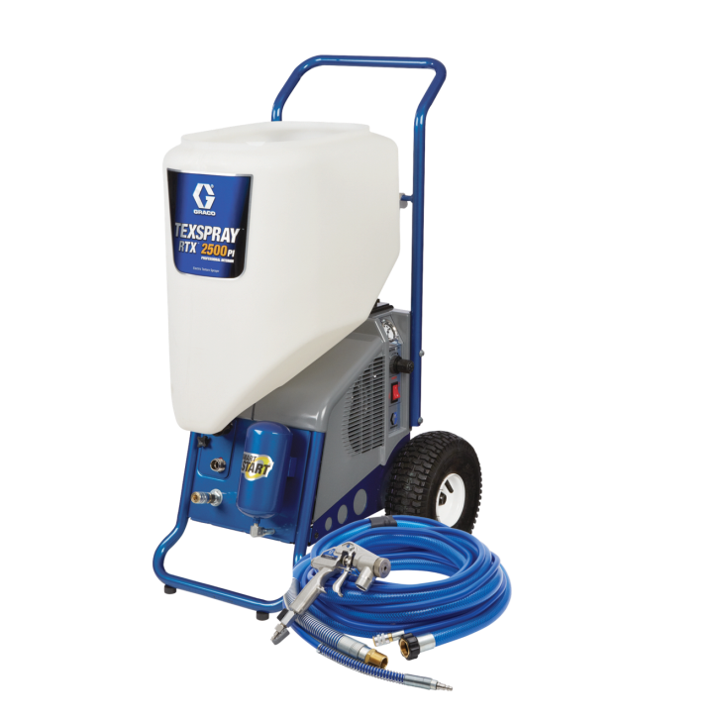
PRODUCT PRICING
2018 US LIST PRICE
DESCRIPTION | PART NUMBER | LIST PRICE | NORMAL NET
RTX 2500PI | 17U219 | $3,700 | $2,220

Slide 12

PRODUCT PRICING
2018 CANADA LIST PRICE
DESCRIPTION | PART NUMBER | LIST PRICE | NORMAL NET
RTX 2500PI | 17U219 | $4,440 | $2,664

Slide 13


LAUNCH INFORMATION
TEXSPRAY RTX 2500PI
GLOBAL Product Launch:
NA January 2018
Product Introduction:
Texture Shows throughout the world - 2018
Product Tech Tour Events:
Throughout 2018
LAUNCH MATERIALS:
Brochures
Manuals
Sales Videos
Website
Updated Graco Sales Book

Slide 14
